Slide 1
Introduction to OOP
Kusal Bista

Slide 2
What is procedure oriented programming?
Programming paradigm that is based on subroutines or procedure calls also known as functions.
Sequential steps that perform some specified tasks.
It prioritizes function over data.
Example: C. Pascal, Fortran.

Slide 3
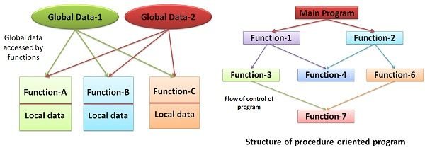

Slide 4
Features
Modularity
Predefined functions
Scoping
Parameter passing
Libraries

Slide 5
Advantages
Portable
General-purpose programming
Functions
Flow tracking

Slide 6
Disadvantages
Global data are vulnerable.
Data can move freely within a program.
Not for large scale.
More time and effort.
Cannot relate to real world.
Not recommended to data sensitive.
Difficult to manage the code and memory.

Slide 7
What is Object-oriented programming?
OOP is a way of computer programming that is based on the idea of “objects” to represent data and methods.
This approach is used to create a neat and reusable code.

Slide 8
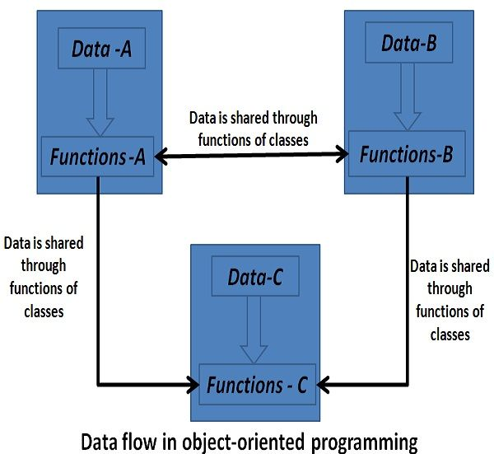

Slide 9
Advantages
Clarity.
Reusable code.
Data and code are bound together.
Secure programs can be built using data hiding.
Redundant codes can be eliminated using inheritance.
Codes can be extended using reusability.
Data abstraction increases reliability.

Slide 10
Features
Inheritance
Encapsulation
Polymorphism
Data abstraction

Slide 11
Features
Inheritance
Inheritance is a technique of acquiring features of objects from one class to the other class objects. In other words, it helps in deriving a new class from the existing one.
Polymorphism:
Polymorphism provides a method of creating multiple forms of a function by using a single function name.

Slide 12
Features
Encapsulation: Encapsulation refers to binding the data and the code that works on that together in a single unit.
Data abstraction:
It allows displaying only the important information and hiding the implementation details.

Slide 13
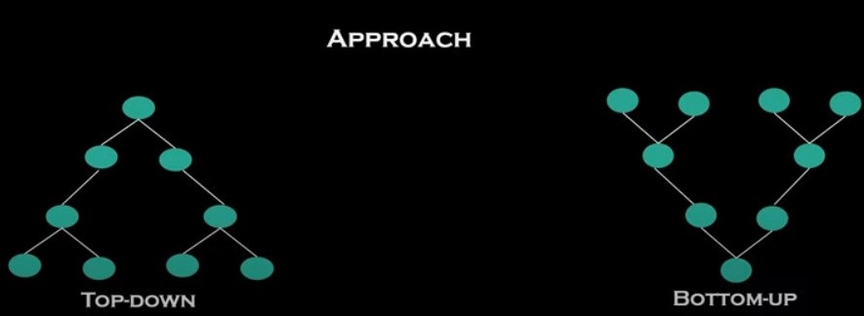
POP vs OOP

Slide 14
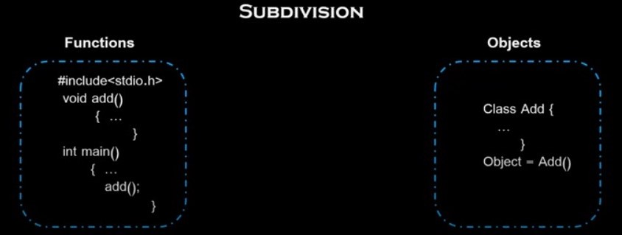
POP vs OOP

Slide 15
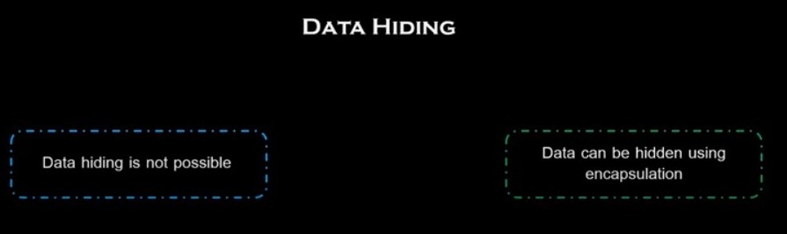
POP vs OOP

Slide 16
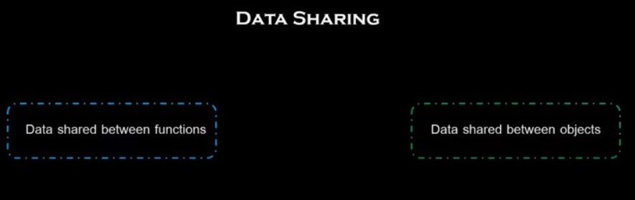
POP vs OOP

Slide 17
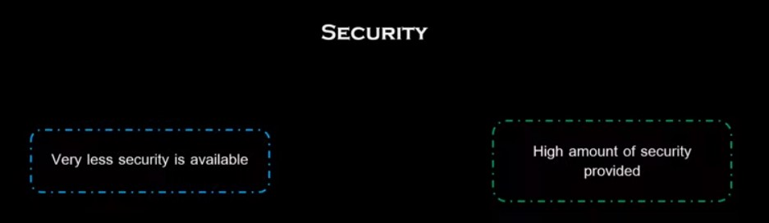
POP vs OOP

Slide 18
Assignment 1
Differentiate between object-oriented programming and procedural programming.

